Slide 1
Digital Portfolio
STUDENT NAME: C.DURGA
REGISTER NO AND NMID: 212400996/ 9FFB165B9DC5F98A77444A7AD4576770
DEPARTMENT: COMPUTER APPLITION
COLLEGE: UNIVERSITY OF MADARS

Slide 2
PROJECT TITLE
DIGITAL PORTFOLIO USING FRONT END WED DEVELOPMENT

Slide 3


AGENDA
Problem Statement
Project Overview
End Users
Tools and Technologies
Portfolio design and Layout
Features and Functionality
Results and Screenshots
Conclusion
Github Link
3/21/2024 Annual Review

Slide 4

PROBLEM STATEMENT
In today’s digital world, showcasing individual skills, achievements, and projects through traditional paper-based resumes and portfolios is becoming outdated and less effective. Recruiters, educators, and organizations prefer quick, accessible, and visually engaging digital platforms to evaluate candidates. However, many students and professionals still lack a structured and user-friendly way to present their personal details, technical skills, and accomplishments online.
There is a need for a Digital Portfolio that provides a centralized, interactive, and customizable platform to highlight one’s profile, skills, and projects in a professional manner. Such a system should be simple, responsive, and easily accessible, making it suitable for academic, professional, and personal use.

Slide 5

PROJECT OVERVIEW
The Digital Portfolio project is designed to create a personalized online platform that effectively showcases an individual’s personal details, technical skills, academic achievements, and projects in a structured and visually appealing manner. Unlike traditional resumes, this portfolio provides an interactive and easily accessible digital space that highlights creativity and professionalism.
The project uses HTML, CSS, and JavaScript to build a responsive, user-friendly, and customizable portfolio website. It allows users to display their profile, educational qualifications, skills, certifications, and project work in an organized format. This enhances career opportunities by offering recruiters, teachers, and peers a quick and clear understanding of the individual’s capabilities.
By implementing this project, students and professionals can establish a strong digital presence, making it easier to share their work, connect with opportunities, and stand out in a competitive environment.

Slide 6

WHO ARE THE END USERS?
The end users of the Digital Portfolio are primarily students and job seekers who wish to present their skills, academic achievements, and projects in a structured and interactive manner. It also benefits professionals looking to maintain a digital resume that can be easily shared with recruiters. Employers and recruiters act as end users as well, as the portfolio provides them with a quick and clear way to evaluate a candidate’s profile. Additionally, teachers and academic institutions can use it to review students’ progress and project work. In general, the digital portfolio serves anyone who wants to view, assess, or showcase personal and professional details in an organized and accessible format.

Slide 7

TOOLS AND TECHNIQUES
The Digital Portfolio project is developed using core web technologies such as HTML, CSS, and JavaScript. HTML is used to structure the portfolio content, while CSS provides styling, layout, and design elements to make the interface visually appealing. JavaScript is applied to add interactivity and enhance the user experience. Responsive design techniques are used to ensure the portfolio works seamlessly across different devices. The coding is carried out using a text editor such as Visual Studio Code, and the output is tested on web browsers like Google Chrome or Microsoft Edge. Additionally, version control platforms such as GitHub can be used for hosting and maintaining the portfolio online

Slide 8
POTFOLIO DESIGN AND LAYOUT
The design and layout of the Digital Portfolio are created to be simple, professional, and user-friendly. The portfolio is divided into well-structured sections such as Home, About Me, Skills, Education, Projects, and Contact. The Home page introduces the individual with a short profile and an image. The About section provides personal details and background information. The Skills section highlights technical abilities using lists or visual indicators. The Education and Projects sections showcase academic qualifications and project work in an organized manner. Finally, the Contact section includes details like email, phone number, and social media links for easy communication. A responsive layout ensures that the design adjusts smoothly across desktops, tablets, and mobile devices, while the use of consistent fonts, colors, and spacing enhances readability and overall visual appeal.
8

Slide 9
FEATURES AND FUNCTIONALITY
The Digital Portfolio provides a range of features and functionalities that make it both useful and engaging. It allows users to display their personal details, academic background, skills, and project work in a well-structured manner. The portfolio is designed to be interactive and responsive, ensuring smooth navigation across devices such as desktops, tablets, and mobiles. Features like navigation menus, clickable links, and contact forms enhance usability and make it easier for viewers to access different sections quickly. The use of CSS styling and animations improves the visual appeal, while JavaScript functionalities enable interactive elements like form validation or dynamic content display. Additionally, the portfolio can be easily customized and updated, allowing users to modify their information whenever required, making it a flexible and professional tool for career growth.

Slide 10
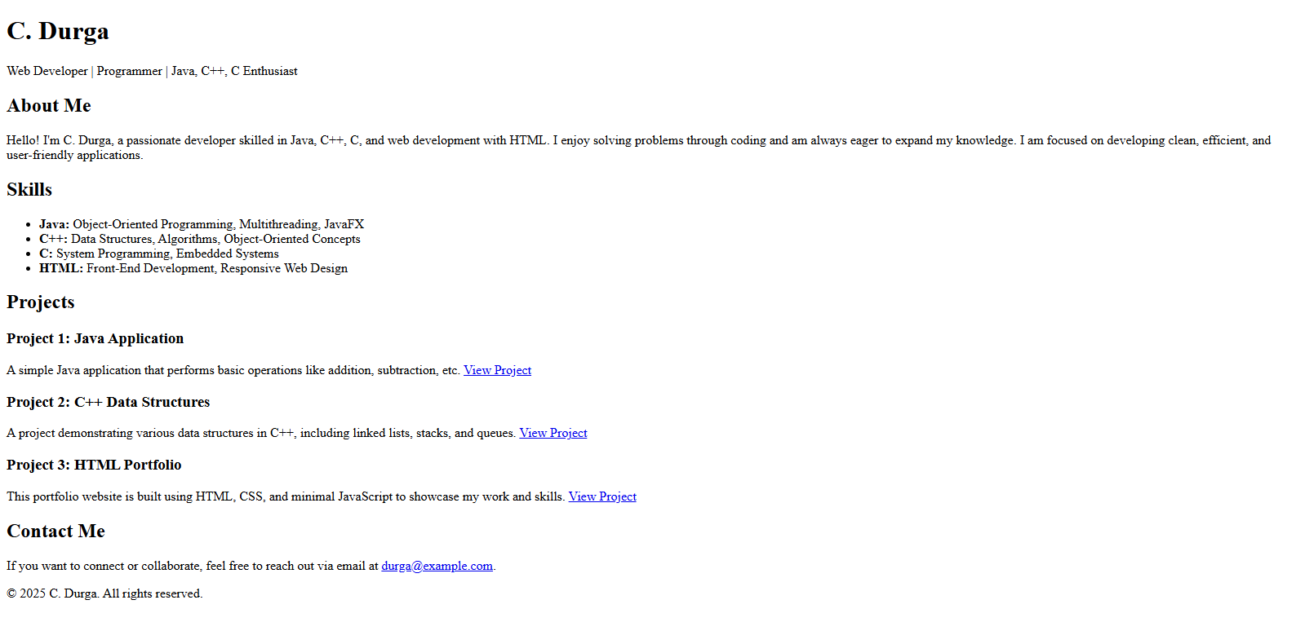

RESULTS AND SCREENSHOTS
The result of the Digital Portfolio project is a fully functional and responsive online portfolio that effectively showcases an individual’s profile, skills, education, and projects in a structured and visually appealing manner. The portfolio is easy to navigate, interactive, and accessible across multiple devices, providing a professional platform for personal branding. It successfully addresses the limitations of traditional paper-based resumes by offering a modern, digital, and customizable solution that can be shared with recruiters, teachers, or peers. Overall, the project demonstrates the application of web development technologies to create a practical and career-oriented tool.
3/21/2024 Annual Review
10

Slide 11
CONCLUSION
.
>Showcase my skills.
>Highlights key projects and achievements effectively.
>Acts as a professional representation of my capabilities.
>Provides an easy way for others to understand my strengths
11

Slide 12
GITHUB LINK
https://13364bca2024-ux.github.io/C.Durga-portfolio/

